Slide 1
Be Informed
Financial Aid for Your College Education
Presenters:
Nicole Mazzella, Assistant Director
Renee Battle, Assistant Director

Slide 2
What is Financial Aid?
Financial aid provides resources to help pay tuition and educational costs
Two Basic Types
  Need-Based Aid
  Merit-Based Aid

Slide 3
Merit-Based Aid
Merit- based aid is typically non-need based and are awarded in the form of scholarships.
May be based on various talent criteria (athletics, grades, essays, competitions, etc.)
Applications have early deadlines

Slide 4
Resources for Merit Based Awards
Private Sources (Rotary Clubs, employers, talent competitions)
Libraries and HS Guidance Offices (index books that list awards)
Specific Academic Departments at institutions
Colleges/Universities (contact admissions dept.)
FASTWEB (www.fastweb.com)

Slide 5
Be a Scholarship Worthy Student
It is important to maintain a G.P.A. (above 3.0)
    Many scholarships are awarded based on G.P.A.
Get involved with your school (join a club, organization, or participate in a sport)
    There are more scholarship opportunities available for those involved in activities
  Get involved with your community
    Go a step beyond, an activity not at school that shows initiative. Participating in speech competitions because you want to, community service, perhaps beauty or talent contests, to name a few.

Slide 6
As a High School Student You Should….
Find Scholarships
  Many organizations give out scholarships, first start looking
    McDonalds
    Miss Illinois
    National Geographic
    Walmart
  Did you know there are organizations that give scholarships for K-12 to go towards your college education?
    Khols

Slide 7

It Pays to Be Involved
Here is an example of how helping in your community pays off.
Khol’s Care Scholarship Program is open to children 6-18 who volunteer in their community. Financial need or academic performance is not consider.
Each Student must be nominated by someone age 21 years or older.
Parents may nominate their own children. HOW great is that !!!!
For more information visit:
http://www.kohlscorporation.com/CommunityRelations/scholarship/official-rules.asp

Slide 8
Apply…Apply…Apply
When applying for scholarships apply to multiple scholarships and
  Search Internet Websites
  School Library
  Books
  College Website that you are applying
  Company sites
  Community Organizations
  Your church

Slide 9
Time to Apply For the Scholarship
(Example: www.fastweb.com)
When you apply for a scholarship through a database such as www.fastweb.com you will be taken through a series of steps.
You will be asked to fill out a self-profile by which they will base which scholarships are right for you. Your profile may include:
    Hobbies
    Sports
    Interests
    Skills

Slide 10
Merit Scholarships Awarded by the College
Generally Awarded by admissions department based on a combination of GPA and standardized test scores
Contact each school directly for more information on scholarships available and how to apply
Schools may have additional scholarship opportunities that require separate applications

Slide 11
Internet Website Recommendations
www.fastweb.com
www.collegenet.com
www.finaid.org
www.scholarships.com
www.collegescholarships.com
www.collegefunds.net
www.petersons.com
www.tuitionfundingsources.com

Slide 12
FAFSA vs. CSS Profile
FAFSA
PROFILE
Free Application
Used by ALL schools administering federal financial aid
Only ask for information about custodial parent
Application Fee
Only used by some schools
Asks for information about non-custodial parents

Slide 13
Who can get federal student aid?
U.S. Citizens or Permanent resident
High school graduate/ GED
Eligible Degree/ certificate program
Valid Social Security number
Males registered for Selective Service

Slide 14
How Financial Need is Determined
COST EDUCATION (tuition, housing, books, etc.)
- EXPECTED FAMILY CONTRIBUTION (EFC)
______________________________________________________________________________________________
=Financial Need

Slide 15
Need-Based Aid
Need based awards are based on the family’s financial situations
Need Based Aid Applications:
FAFSA: Free Application For Federal Student Aid
  FAFSA.gov (Universal Application that you will send to all schools)
CSS Profile: College Scholarship Service
  Profile(Some colleges also require the form to award their institutional aid) Loyola University does not

Slide 16
Need-Based Aid
Need-Based Aid Includes:
    Federal Grants
    State Grants
    Institutional Grants

Slide 17
Federal & State Of IL Grants
Federal Grants:
Pell Grant
SEOG (Supplemental Educational Opportunity Grant)
TEACH Grant
State of Illinois Grant:
MAP (Monetary Award Program)
IIA (Illinois Incentive for Access Program)

Slide 18
Institutional Grants
Many times, the financial aid award will include assistance, awarded based on need from the institution
Usually institutional aid is more common from private institutions.

Slide 19
Loans
Federal Student Loans
      Subsidized Loans
      Unsubsidized Loans
Parent Loan
      Federal PLUS Loan
Private Loan/ Alternative Loan

Slide 20
Federal Stafford Loan
Subsidized and Unsubsidized
Low fixed interest rate a student takes out on their own behalf
No payments while enrolled in school or in deferment.
Repayment begins 6 months after the student graduates or falls below half-time status
Fixed interested rated set by the government

Slide 21
What do I have to do?
During your Senior year you will apply for financial aid through the FAFSA
Your first step is to get a PIN number, your PIN serves as your electronic signature for use on the FAFSA and Direct Loan applications
    Get a PIN at www.pin.ed.gov
      Dependent students: One parent will also need a PIN
      Choose a 4 digit number your will remember
      Don’t tell anyone your PIN!

Slide 22
Federal Parent PLUS Loan
The federal Parent PLUS loan is a low-interest student loan for parents of undergraduate, dependent students.
The interest rate for Direct PLUS Loans is a fixed rate of 7.9%.
The lender will arrange a repayment schedule.
Approval subject to parent credit check
Parent with adverse credit may obtain a credit worthy co-signer
Maximum loan amount is the cost of attendance minus all aid received by the student
Repayment of principal and interest begins 60 days after the loan is fully disbursed.
Parents can opt to let the interest capitalize until the student leaves school.

Slide 23
Private Loans/Alternative Loans
Specialized credit based college student loans designed to provide supplemental funding to cover unmet need
Interest rates and fees for alternative loans can vary
Check with your specific lender regarding the interest rate and if loan consolidation is available
Undergraduate students borrow the funds, but a co-signer will typically be required by the lender
Should be approached as a last option

Slide 24
Federal Work Study
Student Employment
This federally funded, campus-based program offers campus and community-service employment to students demonstrating financial need

Slide 25
How do I apply for aid?
Complete the Free Application for Federal Student Aid (FAFSA) at www.fafsa.ed.gov using your parent previous year’s tax information
      If taxes are not available use estimates
      Add the school codes you wish to receive your FAFSA
By completing a FAFSA you will be considered for:
      Grants
      Loans
      Institutional Grants (Some Schools Require the FAFSA)
      Federal Work Study

Slide 26
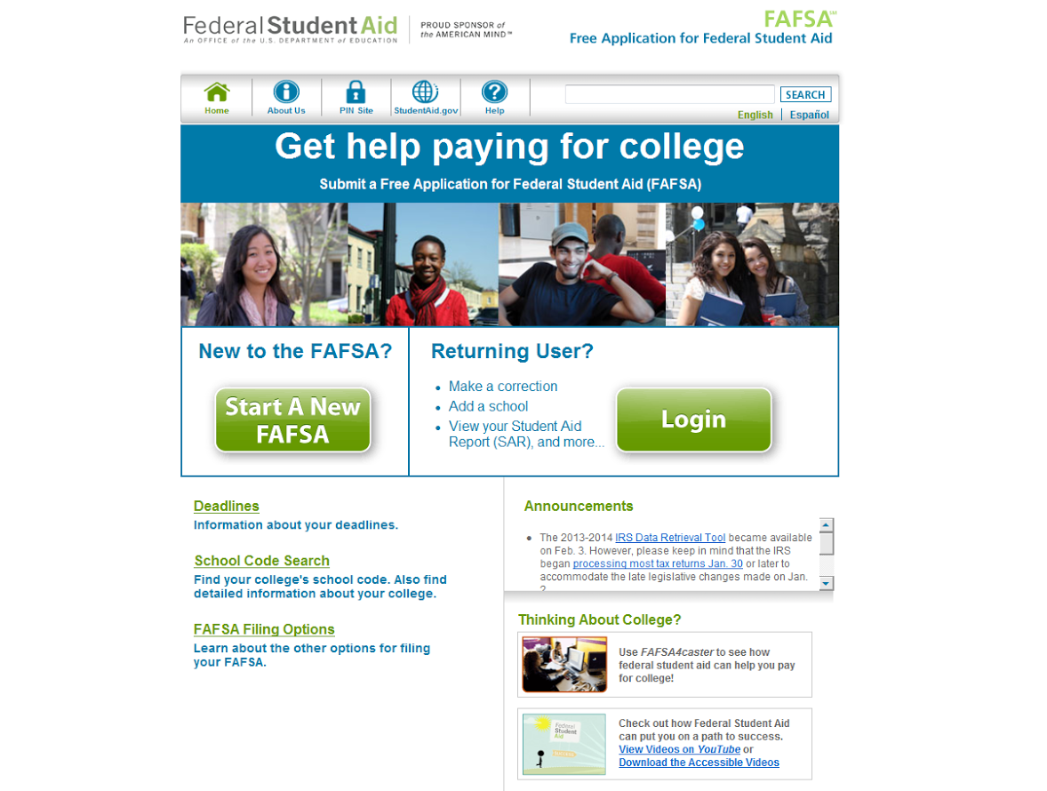
www.fafsa.ed.gov

Slide 27
What Happens Next?
Watch for a response from FederalStudentAidFAFS@cosemail.ed.gov, or by mail
  Check the information on the Student Aid Report (SAR) mailed to you.
  Correct any mistakes
  Update any information
  Check your school codes you provided on the FAFSA
  Watch for e-mails or letters from the schools you are considering
  The school may request additional documents
  Meet all deadlines or could miss out on aid!

Slide 28
Special Circumstances (Appeals)
What if I Have a situation that FAFSA didn’t ask about?
If there are changes in the family situation , the Financial Aid Office may exercise professional judgment to adjust the EFC
Each decision must be addressed on a case-by case basis by the school
Each school may make a different decision, based on the policies of that school

Slide 29
Special Circumstance Appeals
Examples
Loss or Decrease of income- provide an estimate of income for current year, compare to the base year tax return
Unusually high medical or dental expenses
Inflated Income- Retirement Payout

Slide 30
Situations that do NOT need to be Appealed
2 Students in Colleges
Regular household expenses
Mortgage expenses

Slide 31
What is the CSS Profile?
CSS Profile is an online application that collects information that some colleges and scholarship programs use to award institutional aid
    Does not replace the FAFSA
    Schools that do not use the CSS profile have their own method for awarding institutional aid

Slide 32
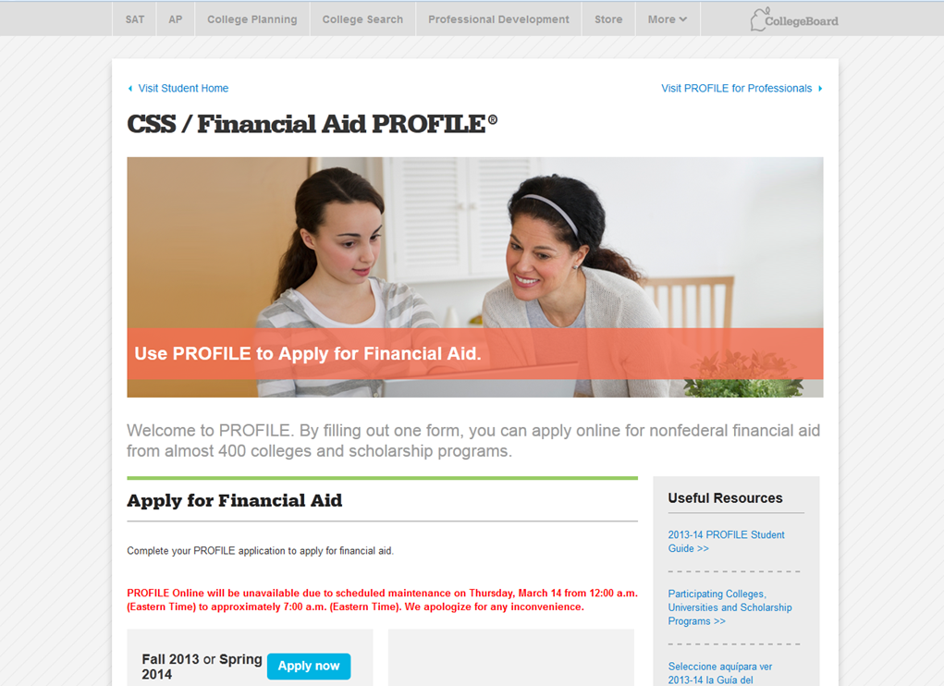
How to file a CSS Profile
You can file at www.collegeboard.org by selecting “Apply for aid with CSS/Financial Aid Profile”

Slide 33
CSS Profile
Ask each school if they require this!
All the students are charged $25 for the initial application and $16 for each additional college or program to which you want the information sent
There are fee waivers automatically granted to students with high need
The profile provides an opportunity to include explanations about special circumstances on the application so the colleges reviewing your information can make their decisions knowing as much as possible about your family
Schools that do not use the PROFILE will have an appeal process to allow you to provide the special circumstance information

Slide 34
CSS Profile
There is a Non-custodial PROFILE. Many colleges using the form believe it is the responsibility of both parent to pay for your college expenses, to the extent they are able even if they are no longer in the same household.
To make a fair assessment of your eligibility for institutional assistance, colleges evaluate your custodial parent’s financial circumstances from information on the PROFILE and your non-custodial parent’s financial circumstances from the Non-custodial PROFILE
The fee for the Non-custodial PROFILE is $25

Slide 35
Information Needed to Complete a CSS Profile
Information to have available when you register:
    Type of tax return you and your parent(s) will file for the current year
    If your parents receive TANF (temporary Assistance for Needy Families) or SSI (Supplemental Security Income)
    If your parents are self-employed or own business(es) and/or farm(s)
    Your parents’ housing status (e.g. own, rent)
    Your personal information, including your Social Security number

Slide 36
Do you need to file a CSS Profile?
Contact each school to see if you are required to complete a CSS Profile
You can also check the College Board website for a list of colleges, universities, and other programs that require the CSS Profile
It can be found at:
www.collegeboard.org
Under Useful Resources
Participating College, Universities and Scholarship Programs

Slide 37
The Award Process and Making a Decision
Deadlines and Priority dates for:
  Merit Scholarship Consideration
  Need-Based Aid
Understanding Your Awards
Verification

Slide 38
Understand Your Award
How much of your balance will be paid by financial aid?
What are the enrollment requirements of the awards?
What is renewable?
Is anything subject to change each year?
Understand the need requirements for grants
How much of your award is comprised of loan that require repayment?
How much debt will you owe after graduation?
What are your scholarship requirements?

Slide 39
Understand the cost of attending
What is the tuition per semester/quarter? Per year? 4 years?
Will tuition increase?
What fees might be assessed?
How much is tuition for a full-time time? Part-time? In-state vs. out of state?
What are the housing requirements? How much is housing?
What different meal plans are offered?
What is the cost of living in the area?

Slide 40
Financial Aid Tips, Common Problems and FAQS
Pay attention to school priority date
Complete your FAFSA early!
  January 1
Use estimated tax information if you or your parents have not filed yet

Slide 41
Don’t assume that financial aid will cover 100% of your expenses
A zero EFC does not mean that you can attend any school for free
You will be eligible for the same amount of federal grants
However Institutional Grants, Scholarships, and Cost of Tuition will vary.

Slide 42
Questions??

