Slide 1
UNDERSTANDING YOUR STUDENT’S PLAN TEST RESULTS
February 28th & March 1st, 2013

Slide 2
Reviewing the PLAN Test

Slide 3
Rationale for taking the PLAN
Academic/College Readiness feedback:
Shows strengths and weaknesses in English, math, reading and science
helps you to determine if student is on track to succeed in first-year college coursework (college ready)
Career feedback:
Careers for students to consider, based on their interests
ACT/College Admissions feedback:
Practice/preparation for ACT
A timed test, same structure/subjects as ACT
Spring of Junior year and/or Fall of Senior year
Provides an estimated ACT Score Range

Slide 4
Score Report: Scores, College Readiness & Career

Slide 5
Side1: Student/School Info

Slide 6
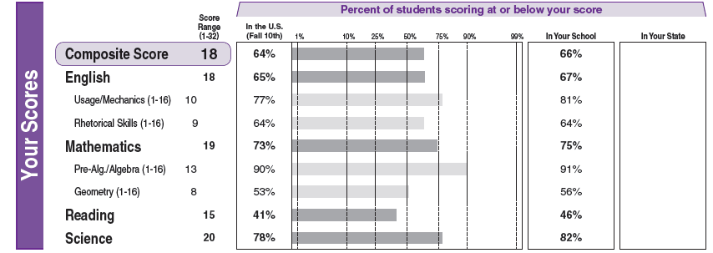
Side 1: Your Scores
PLAN scored 1-32 (ACT scored 1-36)
Average of 4 content area test scores = Composite Score
% of students scoring AT or BELOW student’s score

Slide 7
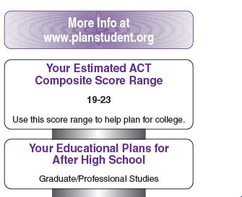
Side 1: Estimated ACT Composite
Estimated range:
Predicts a range of ACT scores assuming NO additional work
Students typically score above this range on ACT
Educational plans:
Student’s self-report of what he/she intends to do after high school

Slide 8
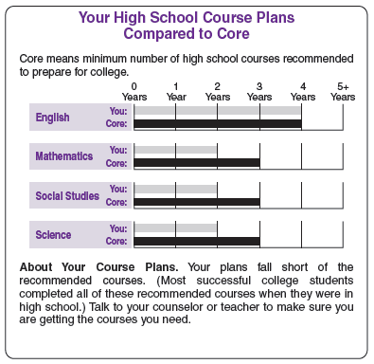
Side 1: High School Course Plans
Top Grey line:
Student’s self-reported plans
Bottom black line:
Core requirements recommended
NOT SWHS Graduation Requirements
Students planning to enter a 4 yr college are encouraged to take all 4 years of all core courses

Slide 9
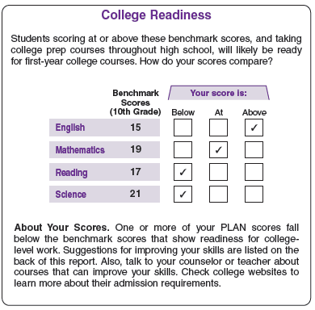
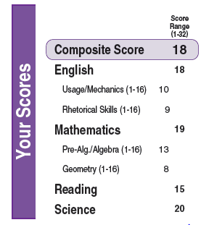
Side 1: College Readiness
College Readiness Benchmarks
Student’s Scores

Slide 10
Side 1: College Readiness
College Readiness: Students are on track to be ready for first-year college courses:
50% earn B or better
75% earn C or better
Benchmark for Science is very high

Slide 11
Side 1: Reported Needs
Needs determined by student, self-reported
Students will be asked to select (or create) 2 needs to become goals
Parents can:
Discuss needs with students
Brainstorm solutions to meet needs

Slide 12
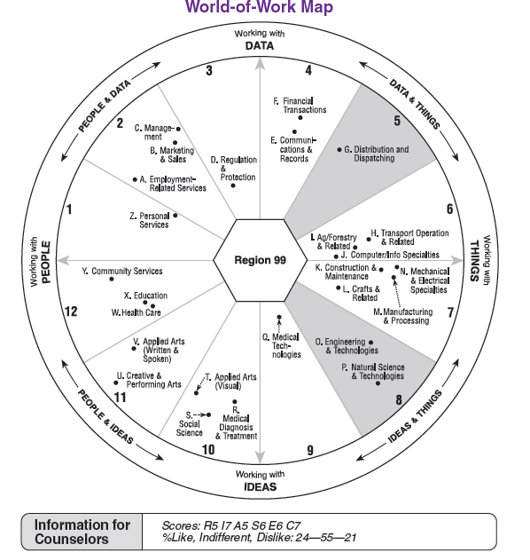
Side 1: Career Possibilities
Highlights indicate students’ interests
Region 99 in center: interests too broad to define
Info for counselors section:
RAISEC Codes
Based on John Holland’s work
Compare to Career Interest Inventory results on Naviance

Slide 13
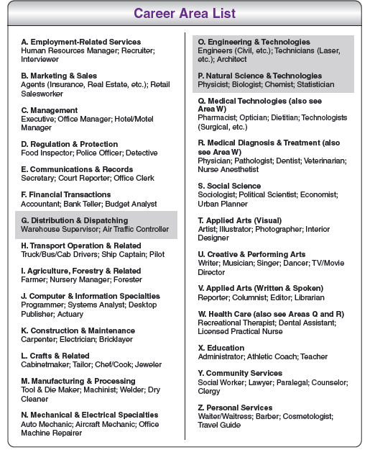
Side 1: Career Possibilities
Highlighted area corresponds to World of Work map
Small sample of careers
Consider general skills or interests rather than focus on listed careers
http://planstudent.org
Additional resources to explore career information

Slide 14
Score Report: Answers & Skills

Slide 15
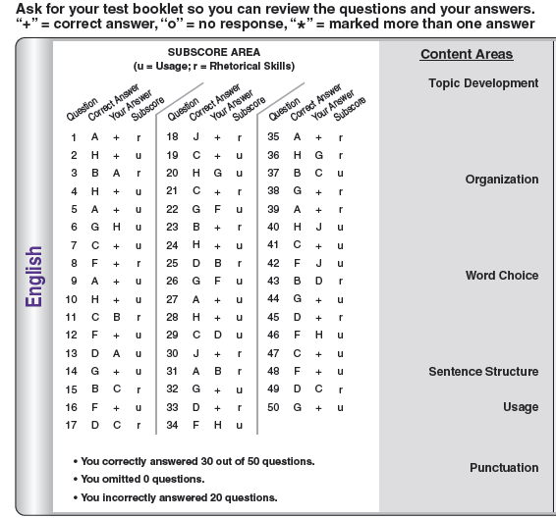
Side 2: Review Answers
Hang onto book for future review
“+” = correct answer
“o” = no response
“ ” = multiple answers marked
Subscore = skill area
English & math only

Slide 16
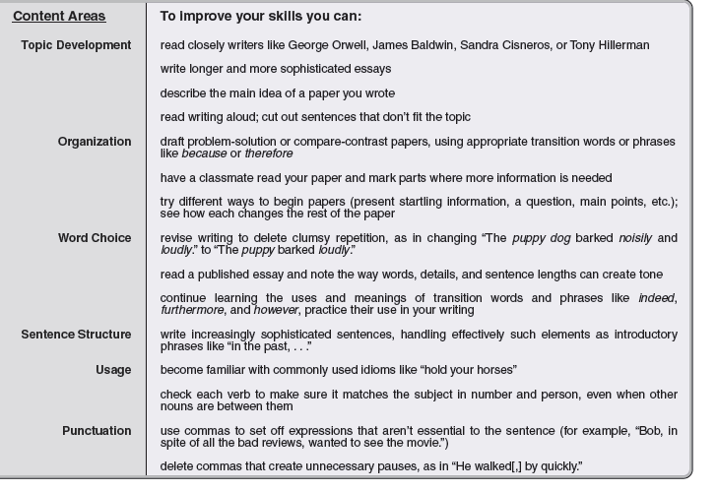
Side 2: Skills

Slide 17
HS Academics & Career Prep

Slide 18
High School Graduation Requirements
4 years of English
4 years of Social Studies
3 years of Math
Algebra II
3 years of Science
Biology
1 year of Fine Arts
1 year of Health and Fitness for Life
Electives to total 64.5 credits
Pass MCA tests in Reading, Writing, and Math
My Life Plan Graduation requirements

Slide 19
HS vs. College Requirements
 | High School | 2 yr Coll. | 4 yr Coll. | Selective 4 yr
English | 4 years | 4 years | 4 years | 4 years
Soc. Studies | 4 years | 4 years | 3-4 years | 4 years
Science | 3 years (see previous slide) | 3 | 3-4 science (physics) | 4 years
Math | 3 years, through Alg 2 | 3 | 3-4 years | 4 years
World Language | ----- | ----- | 2 years of a single lang. | 4 years
Health | 1 year | ----- | ----- | -----
P.E. | 1 year | ----- | ----- | -----
Fine Arts | 1 year | ----- | 1 year | 1-2 years

Slide 20
HS vs. College Requirements
Don’t be a minimum candidate
Explore the specific requirements for the colleges student is interested in
Example: UW-Madison, UM- Twin Cities
Consider career/real world preparation

Slide 21
Colleges: Evaluating Students
Most Important to Least Important Factors (according to yearly NACAC surveys)
Grades in college prep courses
Standardized Admission Tests
Grades in all courses
Class Rank
These factors account for 2/3 of the decision at selective schools
Also want to see
Extracurricular/activities
Community involvement

Slide 22
Earning Credits: Post-Secondary Enrollment Options (PSEO)
Earn High School & College credit
Open to Juniors and Seniors
Provide own transportation
Admission requirements (GPA and Deadlines) vary by institution
U of M—Twin Cities
3.7+ GPA (highly selective)
April 1st application deadline
Normandale
3.0 (Seniors) & 3.3 (Juniors)
July 1st (Fall) and December 1st (Spring) deadlines
MCTC
2.5 (Seniors) & 3.0 (Juniors)
June 1st (Fall) & December 1st (Spring) deadlines

Slide 23
Academic Sanity
Rigorous course selection for junior/senior year
Find courses that student can be successful in
Doesn’t have to mean 7 AP/IB courses
Challenging without overwhelming
Colleges say “most challenging courses that you can be successful in”
Balance
Time for extracurriculars, work, family, homework, etc.
Mental health

Slide 24
Credit Recovery
Don’t wait until the last minute
Includes Health/Gym online!
No information at this time about summer school.
Watch for emails!
Summer school
Information to come out late April
Talk to counselor about needs

Slide 25
Looking Forward

Slide 26
End of 10th Grade
SAT II/Subject Tests?
If taking AP US History
Consider at the conclusion of other AP/IB coursework
http://www.collegeboard.com
June test date:
June 1 (register by May 2)
Investigate if SAT II’s are needed
Locate ACT/SAT test prep on Naviance

Slide 27
Summer: Productive Time Off
Volunteerism
Find something interested in/passionate about
Summer employment
Summer enrichment opportunities
Naviance (colleges, enrichment programs)
Colleges that student is interested in
College research
Visit!
Info in the mail
Students signed up to receive information on day of PLAN test
Does not necessarily mean specific college is a good fit for student
If not interested, recycle!
Career exploration
Job shadow
Scholarship search

Slide 28
Looking Forward: Junior Year
Scholarships—continue the search!
College exploration
Narrow down the list
PSAT
Qualifying test for National Merit
Offered in October, students will need to register
Parent Nights
College Search I: November
Financial Aid
General Financial Aid: October
FAFSA Night: January
College Search II: April
Designed for Seniors, but all are welcome to attend

Slide 29
Looking Ahead: Tests for College
PLAN
practice ACT test
all MPS 10th graders take
PSAT
Preliminary SAT
Nat’l Merit Scholarship Qualifier (11th grade)
Optional for 10th and 11th graders, in fall
Choose ACT or SAT to focus test prep time/resources in; okay to “try” one of each, but then focus on one
ACT
Structured like PLAN (4 subjects)
Recommended1-2 times spring of 11th (Perhaps 1 time fall of 12th grade)
Offered 6 times a year, on Saturdays
SAT
Structured like PSAT (3 subjects)
Recommend 1-2 times spring of 11th
(Perhaps 1 time fall of 12th grade)
Offered 7 times a year, on Saturdays
12th Grade 11th Grade 10th Grade

Slide 30
Looking Ahead: Tests for College
Other Tests Colleges may require or consider:
SAT II/Subject Tests
Take at conclusion of subject course
Offered 6 times a year, on Saturdays
AP Tests
Advanced Placement Tests
Take at conclusion of subject course (May)
Placement Tests
Accuplacer

Slide 31
Managing College Prep Sanity
(1) Check in on any unrealized expectations you may have for your student; work to stay aware and on top of any college anxieties you have for your student
(2) Supportive language goes a long way (“Honey, I thought you’d do better…” could be rephrased)
(3) Be intentional about setting aside regular “college free” time where college talk is not allowed (example: mealtimes, Sundays)
(4) Work with your student to create a college communication plan- how much information to share with family, friends, peers, etc.
(5) Remember that your student is the project manager

Slide 32
The message your students will get:
Your scores are a snapshot of your knowledge and abilities
-Test scores matter… your coursework matters more
-Learn from this experience for future tests
Your PLAN Score Report is Yours:
-These scores belong to you and your parents
-Respect your classmates, don’t ask for scores
-Set the Standard for the Class of 2015

Slide 33
Questions?

Slide 34
Resources
SWHS Counseling Website- Testing
www.planstudent.org
Name Email Phone Caseload - Grades
Dick Schwartz richard.schwartz@mpls.k12.mn.us 612.668.6059 DP Coordinator
Holli Hoffman holli.hoffman@mpls.k12.mn.us 612.668.3082 MYP Coordinator
Teresa Savage teresa.savage@mpls.k12.mn.us 612.668.3053 A-E 9-12
(for Mary Morseth)
Jean Sherwood jean.sherwood@mpls.k12.mn.us 612.668.3052 F - K 9-12
George Mountin george.mountin@mpls.k12.mn.us 612.668.3051 L - Q 9-12
Janelle Kreisher janelle.kresiher@mpls.k12.mn.us 612.668.3054 R -Z 9-12
Danielle Jastrow danielle.jastrow@mpls.k12.mn.us
Kate Van Pernis katherine.vanpernis@mpls.k12.mn.us 612.668.3065 A -Z 9-12

