Slide 1
Playing College Sports
in the NAIA
Presenter Name
Presenter Title
@Play_NAIA
#NAIAEligibilityCenter

Slide 2
About the NAIA
The NAIA exists to advance character-driven intercollegiate
athletics
The NAIA provides high school student-athletes the opportunity to keep playing sports while receiving an outstanding education
Every student-athlete matters and receives the personal attention they need to succeed
The NAIA intentionally teaches character and prepares student-athletes to be tomorrow’s leaders

Slide 3
Keep playing
60,000 student-athletes play in the NAIA today
The NAIA has colleges and universities throughout the U.S.
Student-athletes have the chance to compete in 23 national championships
NAIA student athletes receive more than $450 million in athletic scholarships annually

Slide 4
NAIA sports

Slide 5
Sports offered in the NAIA
Championship Sports
Men’s and Women’s Cross Country
#NAIAxc
Football
#NAIAfootball
Men’s and Women’s Soccer
#NAIAsoccer
Women’s Volleyball
#NAIAvolleyball
Men’s Basketball (two divisions)
#NAIADIMBB #NAIADIIMBB
Women’s Basketball (two divisions)
#NAIADIWBB #NAIADIIWBB
Men’s and Women’s Swimming and Diving
#NAIAswim
Men’s and Women’s Indoor Track and Field
#NAIAtrack
Wrestling
#NAIAwrestle
Baseball
#NAIAbaseball
Men’s and Women’s Golf
#NAIAgolf
Softball
#NAIAsoftball
Men’s and Women’s Tennis
#NAIAtennis
Men’s and Women’s Outdoor Track and Field
#NAIAtrack
Emerging Sports
Men’s Volleyball
Men’s Bowling
Women’s Bowling
Competitive Cheer and Dance

Slide 6
Where are NAIA schools located?

Slide 7
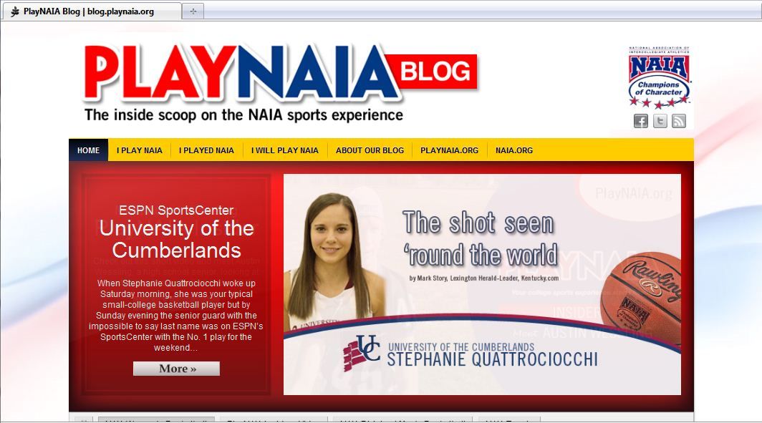
Connect with the NAIA

Slide 8
Connect with the NAIA
blog.PlayNAIA.org
www.facebook.com/PlayNAIA
www.twitter.com/Play_NAIA

Slide 10
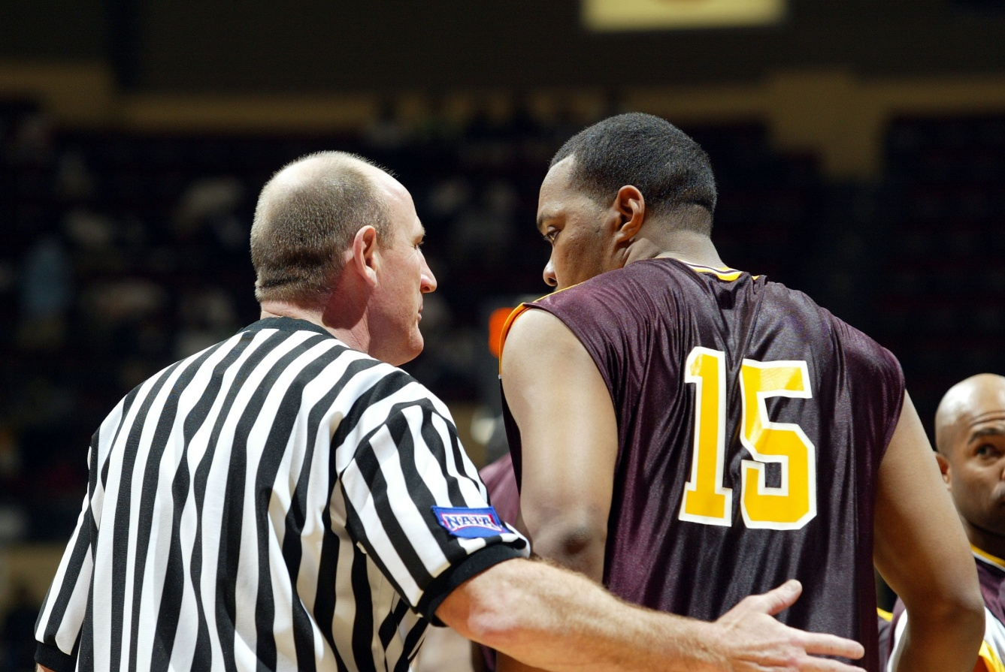
Champions of Character

Slide 11
Champions of Character
Champions of Character provides training to ensure NAIA student-athletes know, do and value the right thing in all areas of life
Five core values: integrity, respect, responsibility, sportsmanship and servant leadership
These values are put into play, accounted for and measured at all NAIA schools

Slide 12
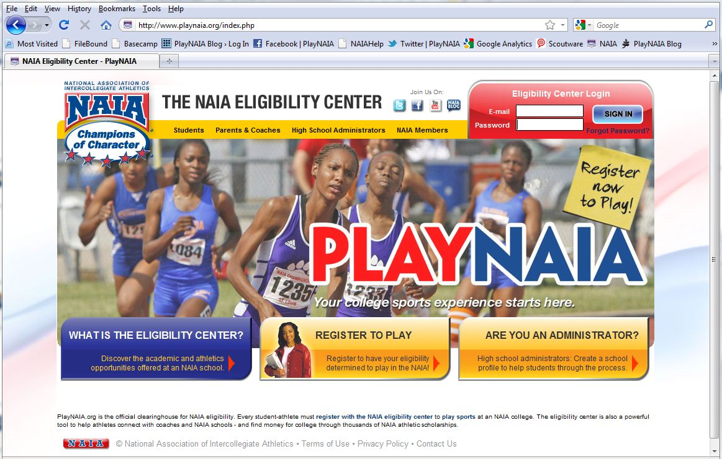
The NAIA Eligibility Center

Slide 13
The NAIA Eligibility Center
The NAIA Eligibility Center determines the academic and athletic eligibility of all prospective student-athletes
It delivers on our larger promise of integrity by ensuring not only inbound eligibility but a level of fairness among competitors
Student-athletes who register have a unique opportunity to connect personally with NAIA coaches before choosing their college

Slide 14
Register with the NAIA Eligibility Center

Slide 15
Register with the NAIA Eligibility Center
All first-time NAIA athletes must register
NCAA and NAIA are different; if you want to play at an NAIA college or university you have to register with the NAIA Eligibility Center
Register at www.PlayNAIA.org

Slide 16
Registration fees and waivers
Fee = $65 for U.S. students and $95 for international students
Fee waivers are available based on need
HS students – ACT/SAT fee waiver or participation in free/reduced school lunch
College transfer students – Pell Grant of at least $4,500

Slide 17
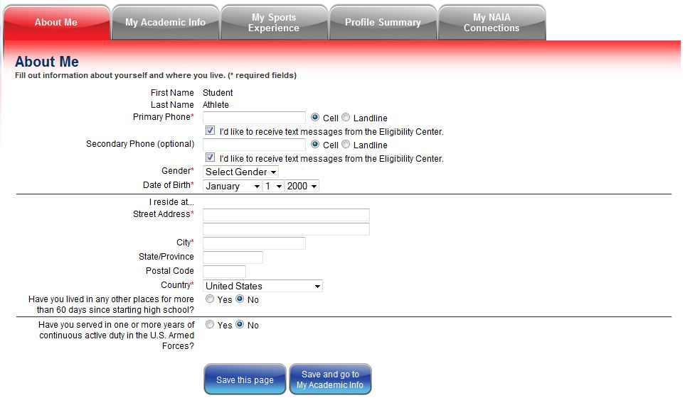
Create online student profile

Slide 18
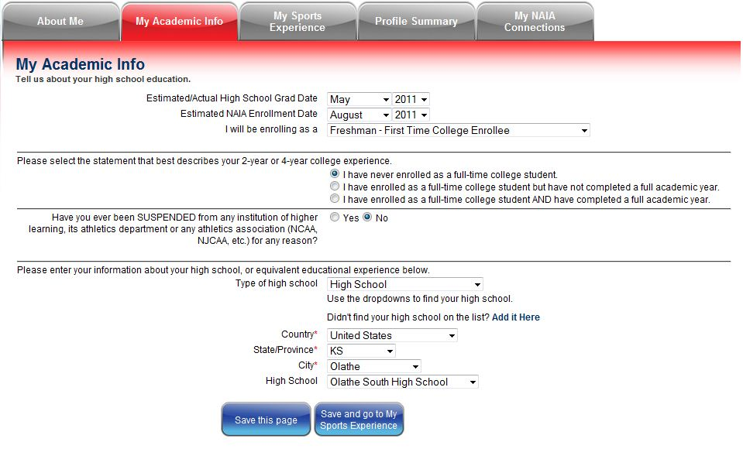
Create online student profile

Slide 19
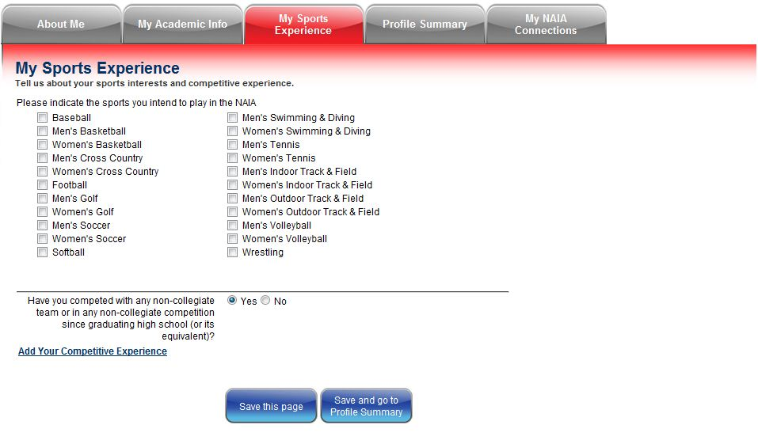
Create online student profile

Slide 20
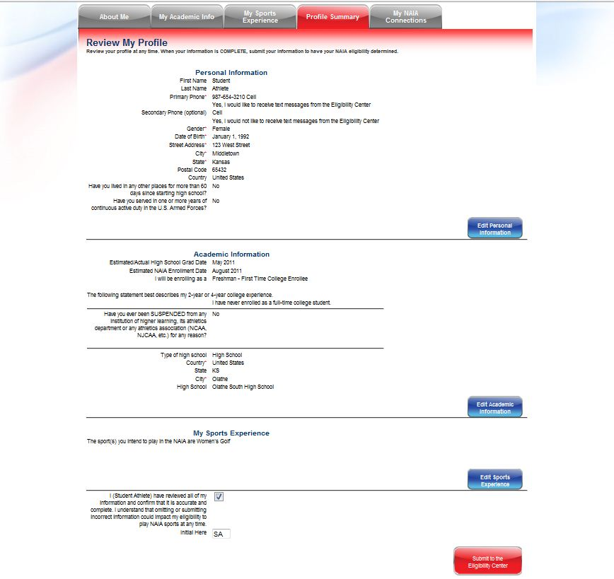
Check your profile info before submitting

Slide 21
NAIA eligibility requirements
Graduating HS seniors must meet 2 out of 3:
Minimum GPA of 2.0 on 4.0 scale
18 ACT or 860 SAT
Graduation in top 50% of class

Slide 22
Submit ACT/SAT test scores
List the NAIA as one of the places you want your scores sent
Use our code: 9876
Contact ACT or College Board to have scores sent if you have already taken the test

Slide 23
More about the ACT and SAT
SAT score is the combined math and reading scores
ACT is the composite score
Writing sections are not used for eligibility
Score must be achieved in one sitting

Slide 24
Sending transcripts
Transcript must be official
Transcript must come directly from your school
Send only one high school transcript
Send transcript after high school graduation unless you qualify to receive an Early Decision

Slide 25
Early Decision requirements
18 ACT or 860 SAT
At least a “B” average (3.0 on a 4.0 scale) after the completion of junior year of high school OR at least a 2.5 on a 4.0 scale midway through senior year
If you qualify, send us your transcripts early to receive a determination before graduation

Slide 26
Attending an NAIA school
NAIA Eligibility Center determinations are separate from admission to college
Check with the school you are interested in to find out about admissions requirements and scholarship opportunities

Slide 27
NAIA Connections
Create a customized Sport Resume and send it directly to NAIA coaches
Include athletic achievements and any other academic or community involvement you want schools to know

Slide 28
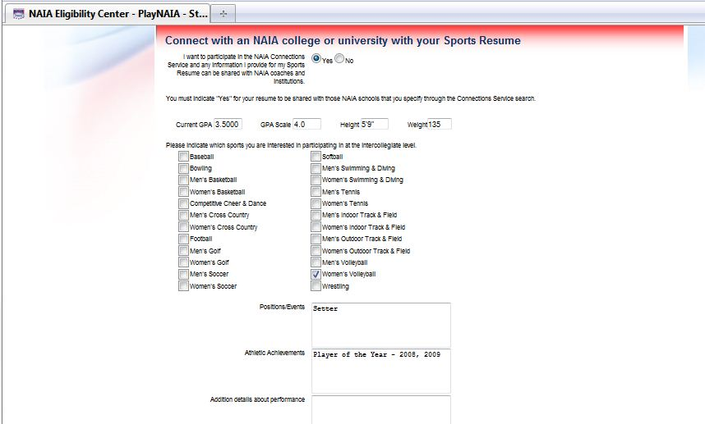
NAIA Connections

Slide 29
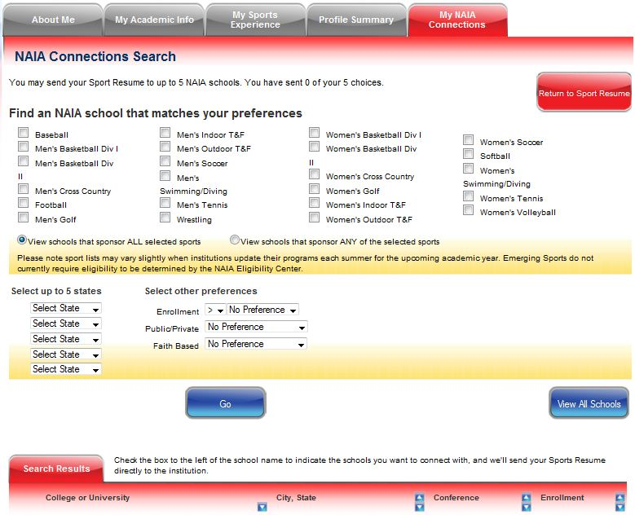
NAIA Connections – Search for schools

Slide 30
Short List
Made up of a coach’s most serious recruits
Determines priority in the NAIA Eligibility Center’s workflow
Each school and coach decides who to place on the Short List, but students must be registered first
To find out if you are on a Short List, or to be placed on a Short List, contact your NAIA coach

Slide 31
After you are registered
Registration status will be “Pending” until someone on staff begins to review your case
It is not necessary to receive a determination before accepting a scholarship or a place on a school’s team
Register early to avoid delays

Slide 32
Need more information?
Visit www.PlayNAIA.org
Email ECinfo@naia.org
Call 866-881-6242

Slide 33
Are you ready to PlayNAIA?
Get started today:

